Slide 1
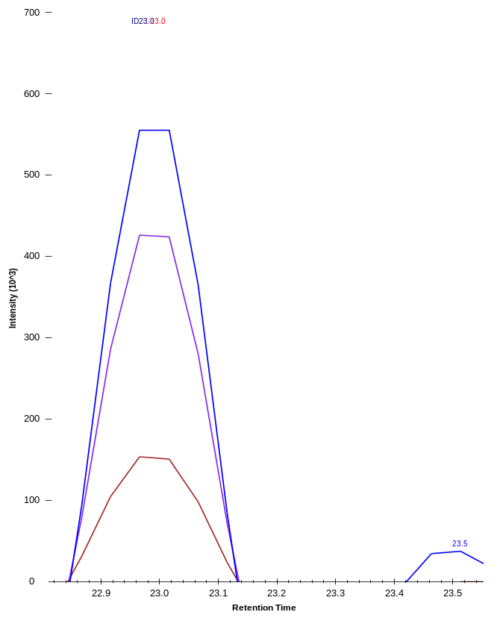
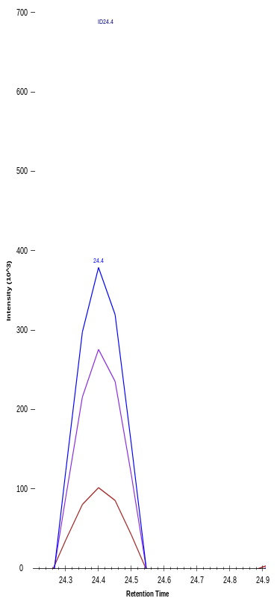




A.
FASN
VTAIHIDPATHR
Control
Vermentino
EtOH
Intensity
Intensity
Retention Time
Retention Time
B.
*
Vermentino EtOH
C 100 200 400 µg/mL
245-
180-
FASN
Fasn mRNA level
(relative to C)
1.0±0.1 1.1±0.1 0.8±0.1 0.6*±0.1
63-
48-
P-AKT
1.0±0.1 2.6±0.1** 3.6±0.1Ɨ 4.8±0.2Ɨ
63-
48-
AKT
1.0±0.1 1.1±0.1 1.1±0.1 1.1±0.1
48-
35-
C 100 200 400
β-Actin
μg/mL
Supplementary Figure 2

